Slide 1
Bar Soap (Chemical Reaction) Product Defect Minimization &Production Process Optimization

Slide 2
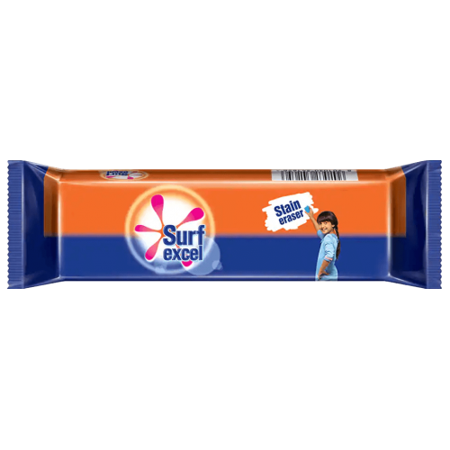
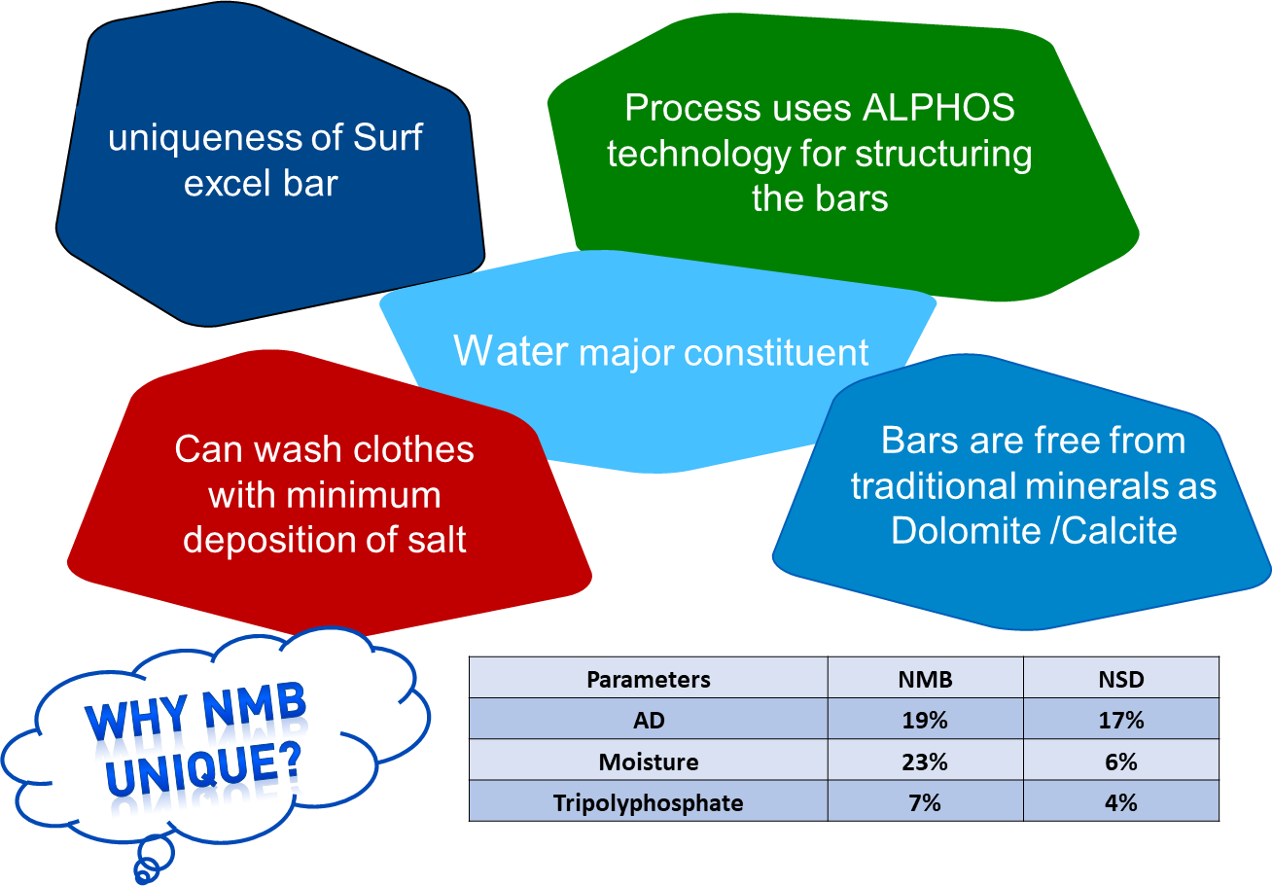

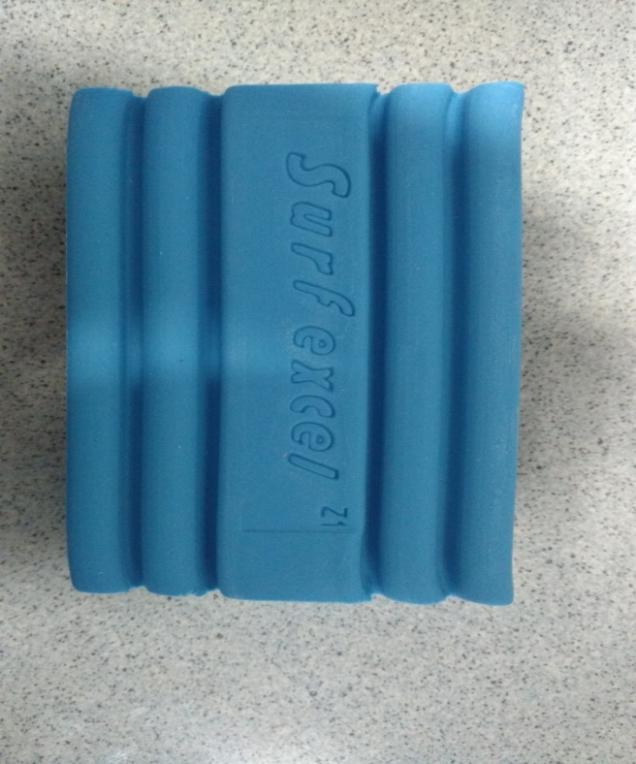

WHAT IS NMB?
NIL MINERAL BAR

Slide 3

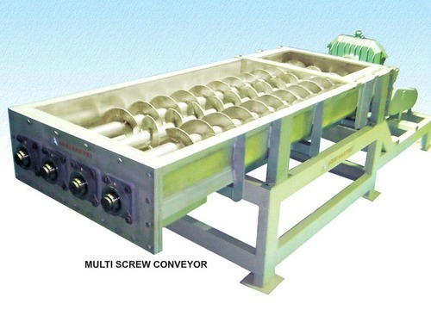
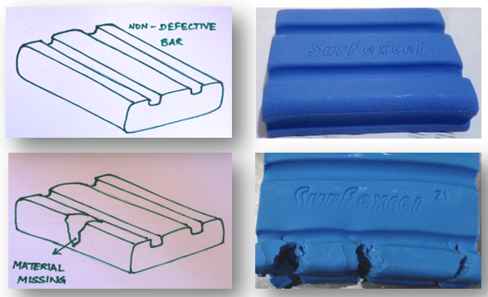
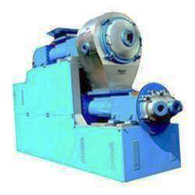
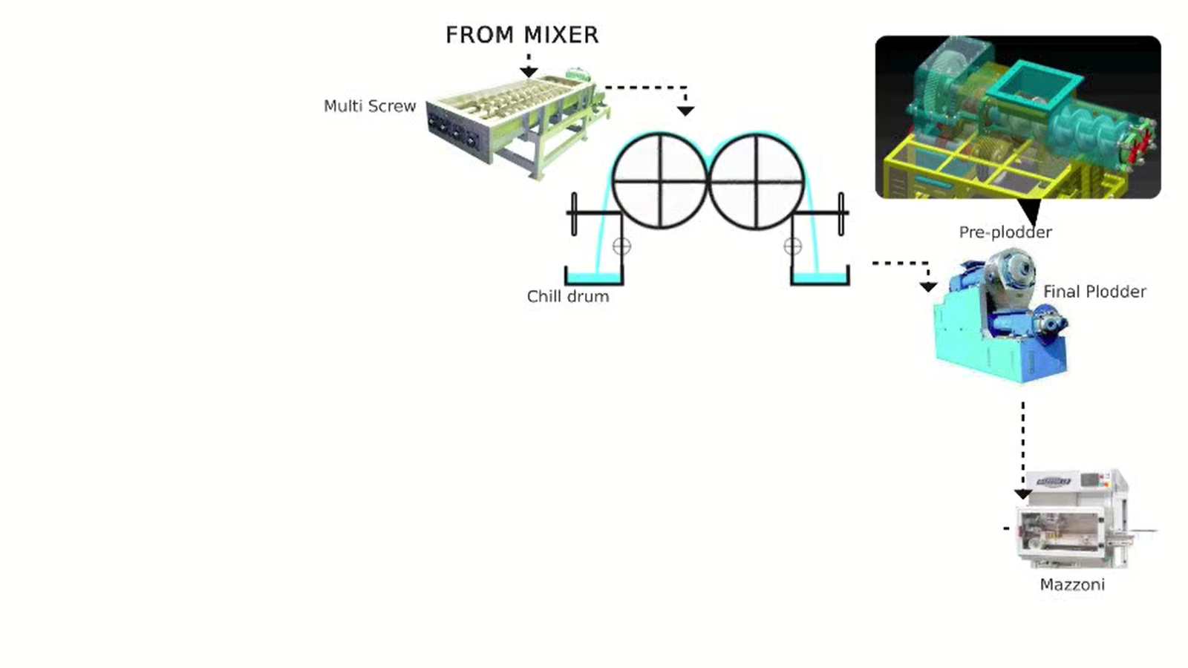
VARIABLES INFLUENCING NMB
Batch making process
Batch RM input
Motor & Gear box
LIQUID RM QUALITY PARAMETERS
SOLID RM QUALITY PARAMETERS
RM DOSING QUANTITY
RM DOSING TIME
BATCH START TIME
BATCH STOP TIME
SODAL DAY TANK TEMP
DOSING TEMP
SPEED
CURRENT
VIBRATION
TEMPERATURE
Output parameters
PENETRATION VALUE (PV)
ACTIVE DETERGENT (AD)
TABLET TEMPERATURE
GRIT
WHITE PATCHES & BAR CRACKING
Mixer
Motor & Gear box
SPEED
CURRENT
VIBRATION
TEMPERATURE
Multi screw input
Multi screw
Multi screw hopper level
Chill drum input
Plodder input
Sparger inlet water pressure
Gap between drum
CD INLET WATER TEMP
CD Inlet water flow rate
CD OUTLET WATER TEMP
Chill drum blade pressure
NMB flake temperature
CD RPM
PLODDER VACUUM
PLODDER RPM
GAP BETWEEN WORM AND BARREL
PLODDER LEVEL
PLODDER INLET WATER TEMP
PLODDER OUTLET WATER TEMP
DIE TEMPERATURE
PLODDER VACUUM
Plodder
Motor & Gear box
Motor & Gear box
SPEED
CURRENT
VIBRATION
TEMPERATURE
SPEED
CURRENT
VIBRATION
TEMPERATURE

Slide 4
PROJECT DEFINITION
Line
Nmb cascade 1
Rm quality parameters
Process
mapping
formulation
Nmb formulation (alphos technology)
Data source
Batch details
Defect data
Process parameters
Operation principle
Mixing, crystallization & plodding
Final product quality
Following questions needs to be answered from initial data insights & modelling
objective
Optimize formulation integrity to achieve each batch as golden batch
What should be input data variability to be within golden batch zone?
Which inputs are the key influencers?
Pv 20 to 26
Ad 17.43 to 18.43
How these key influencers vary final batch produced?
Key performance indicators
Tablet temp max 55⁰
NO GRIT
Is there a model that predicts variations in mix, which takes batch out of golden batch zone?
No bar cracking
No white specs
Can model predict & suggest the defined action to be triggered before mix?

Slide 5



Data Science Approach
Descriptive
Predictive
Prescriptive
(Semi-Auto/ Auto)
Ready to Deploy
What is the overall trend?
Key Predictors
Validate assumptions
Validate technical concepts
Is there any pattern in the data?
Is there a function that can explain the process/data?
Is the prediction accurate?
Based on prediction values, is there a optimization model to suggest new set points for minimizing loss or variability?
These suggested set points are accurate and follow process safety/quality environment requirements?
Could suggested set points automatically drive process changes in a safe mode?

Slide 6
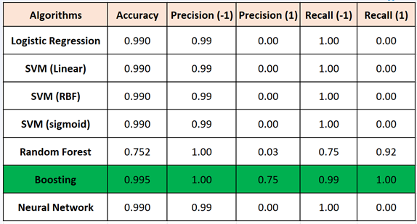
Prediction Modeling for Grit
Boosting has the best performance for each Mixer.
Best

Slide 7
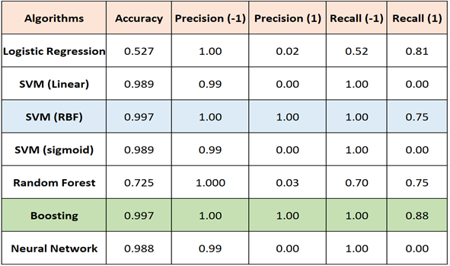
Predictive Modeling for Bar Crack
Best

Slide 8
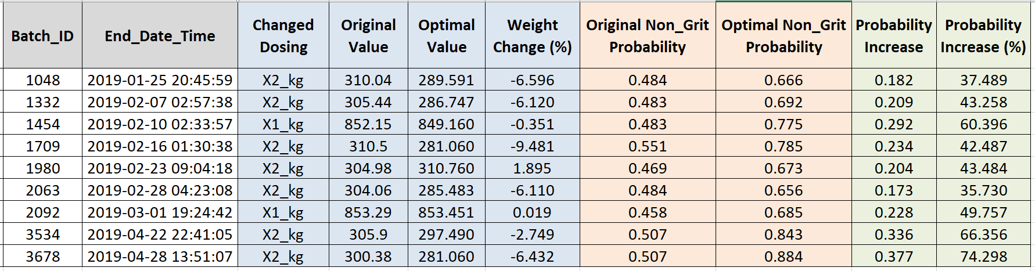
Prescriptive Recommendation for Grit
Significant increase!

Slide 9
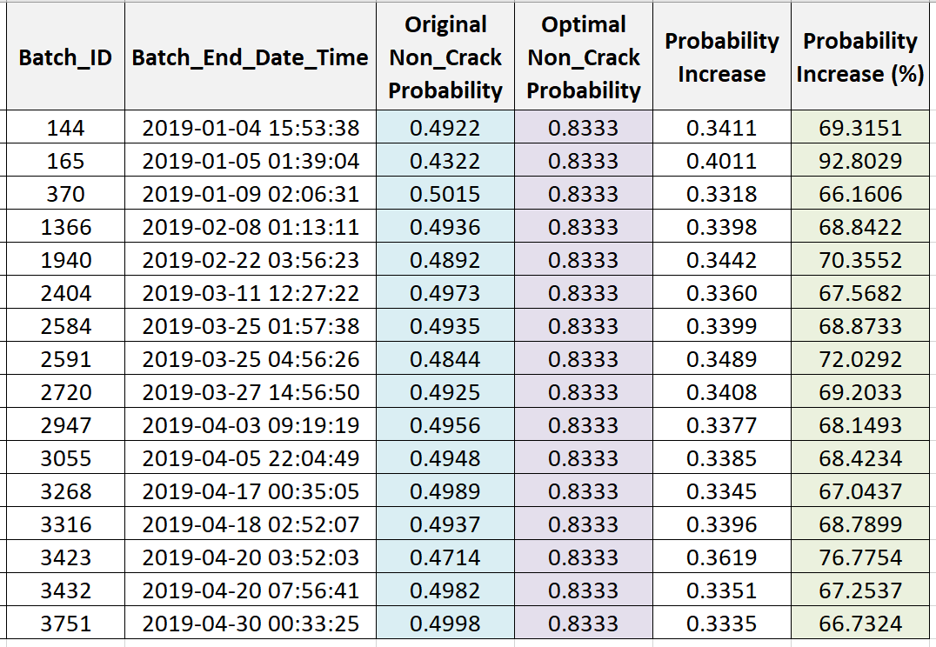
Prescriptive Recommendation for Crack:
.
Significant increase!

